Slide 1
Sleep for 8-9 hours every night
30-day challange

Slide 2
Why I am chose this challenge?
Normaly I sleep 5-6 hours
I went to sleep late and I got up early
I know it's not good, but I've already qualified.
At online school I have to change because on normal they I don’t have 1st class

Slide 3
Our brain is active
It takes all of the information we absorbed during the day, processes it, forms the right associations and puts it into long term storage.This is critical for human functioning because, upon rising, the brain is rid of any unnecessary junk leaving space to store new memories and communicate with the rest of our body. That’s why kids need so much sleep – because they take in so many new things that need to be processed and filed away.

Slide 4
The body repairs and regenerates itself.
It sees an increase in growth hormones and testosterone which are necessary for muscle repair, as well as the health of your immune, digestive, musculoskeletal, and endocrine systems. Cut your sleep by an hour and the results are noticeable – on our faces, our performance and even in our blood.

Slide 5
NOT ALL SLEEP IS CREATED EQUAL
There are two more things that are worth understanding about sleep: First – we sleep in stages – light sleep (stage 1 & 2) and deep sleep (stages 3-5). The deep sleep is where all of the memory consolidation work gets done. Which means that we need to aim for better, deeper sleep, and not necessarily more of it.

Slide 6
Create a bedtime routine:
Our bodies like predictability. They’ll work better when you sleep and rise at the same time. The key here is to start winding down at least 30 minutes before bed, getting your brain into a more restful state, and to find what group of activities benefit you the most.

Slide 7
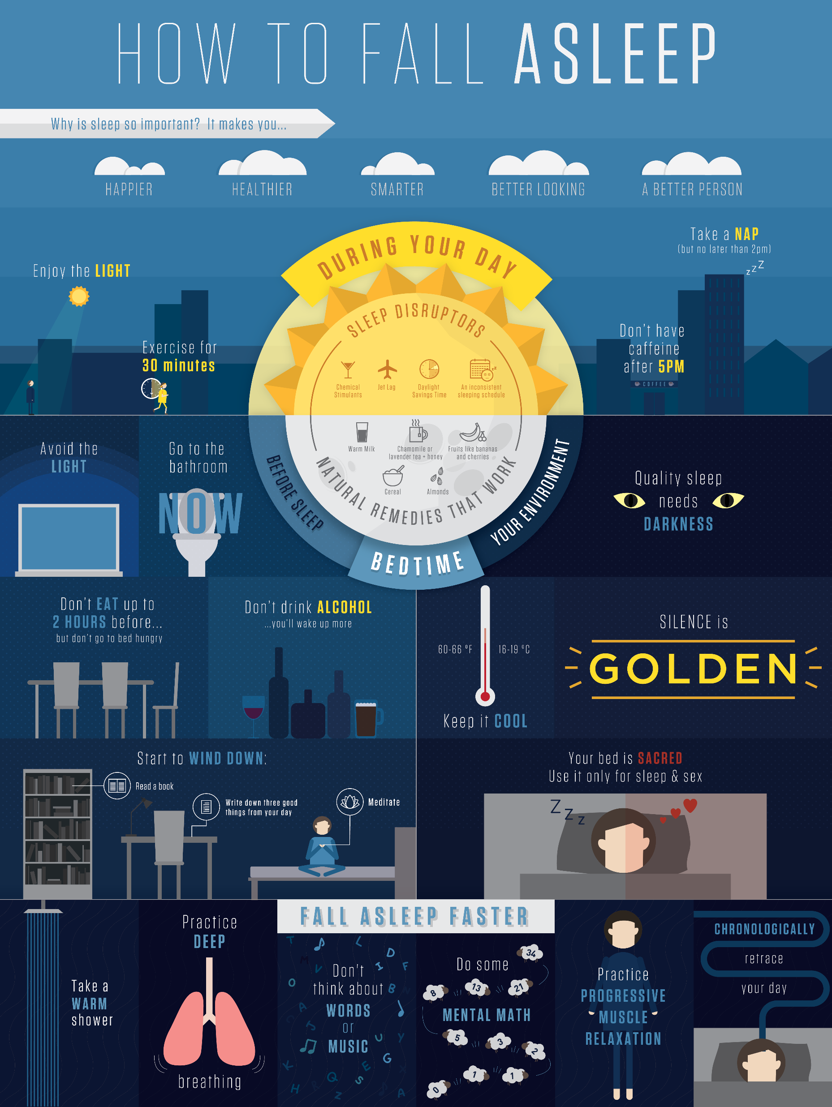
How to fall a sleep

Slide 8
Thanks for watching
Mark Nyikes-Vanó

