Slide 1
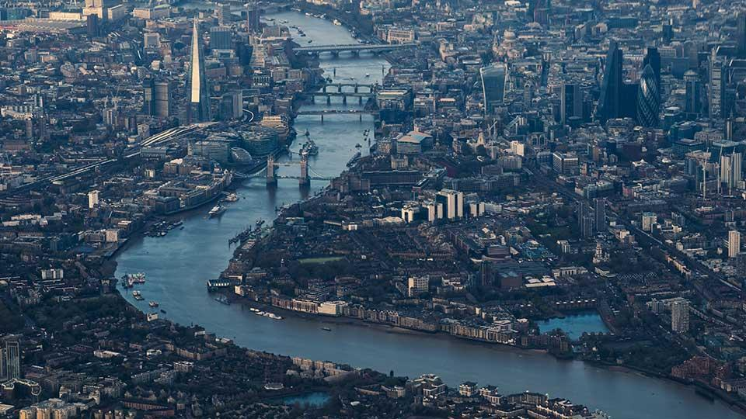
London
made by: Botond Rákász

Slide 2
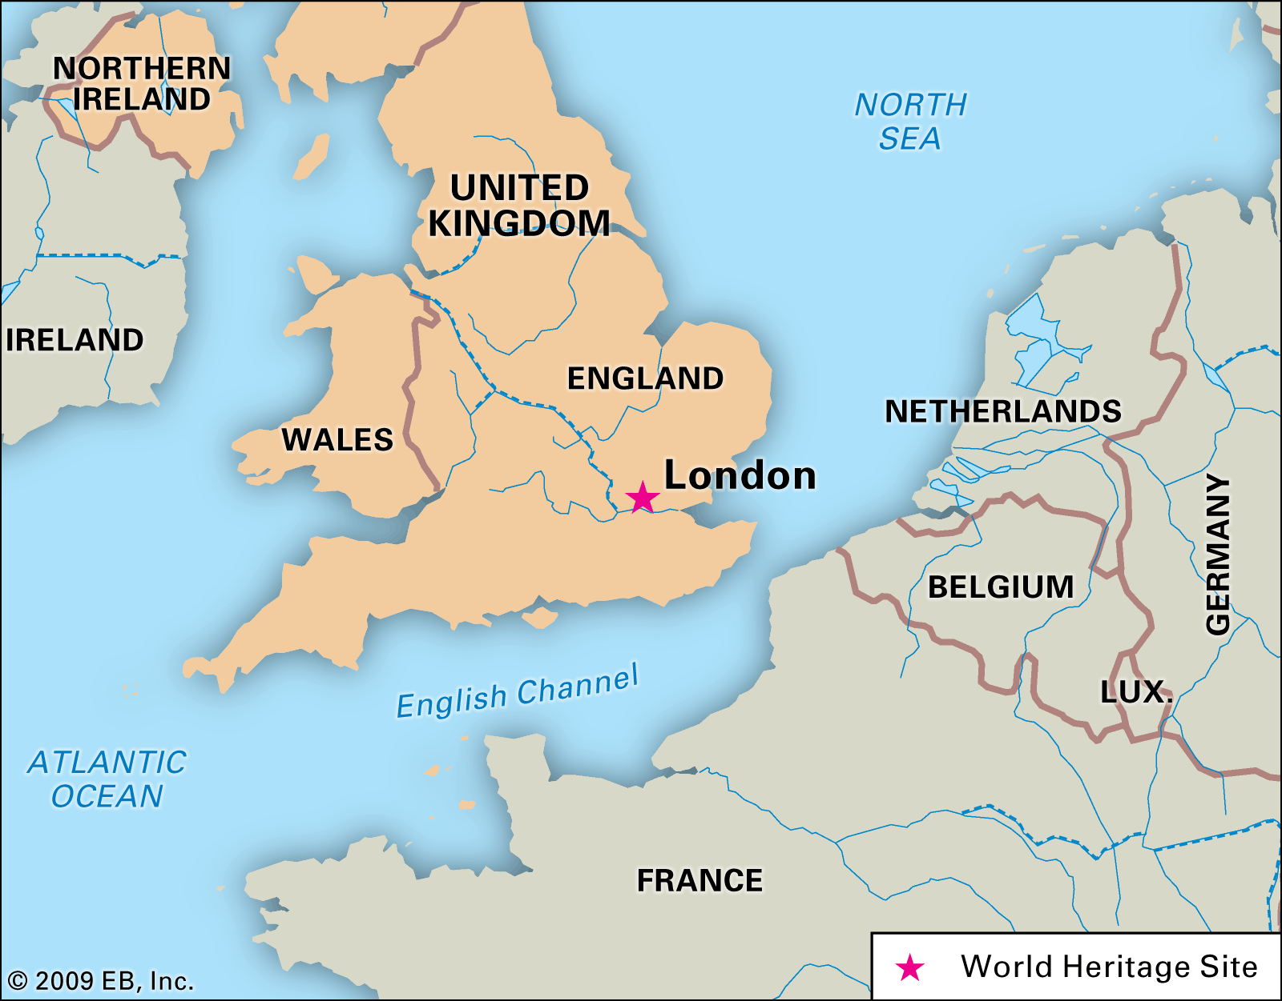
Location
South-east England
On River Thames
In Thames Valley
Area: 1,572 square kilometers

Slide 3
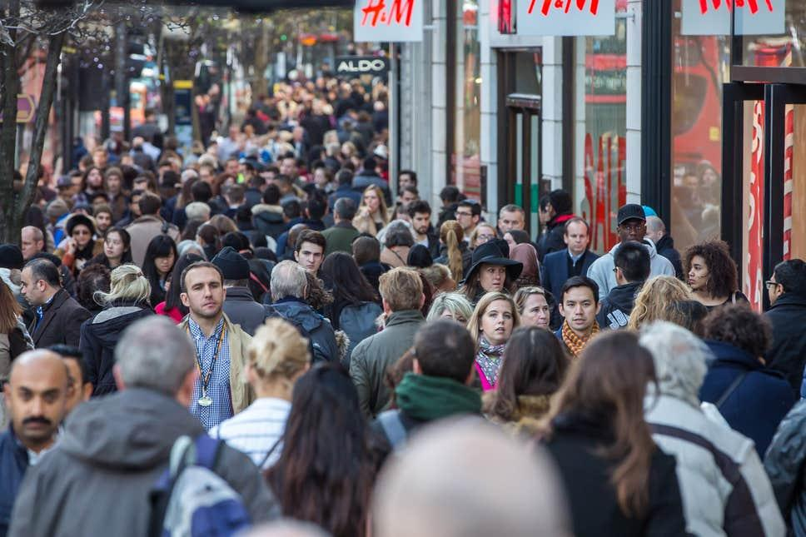
Population
in 2019 the population was 8,982 million
The largest religion group is Christian
45% of the population is white, 21% is asian, 15% is black and 19% is other/mixed

Slide 4
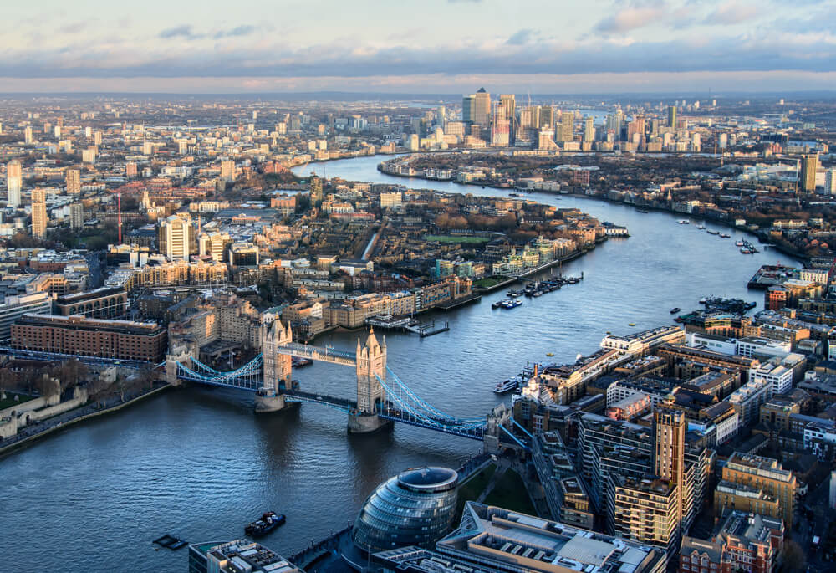
River Thames
The length of the river is 346 kilometers
it has more than 80 islands
Thames means “darkness” in Latin
In some parts they call it Isis
It’s the longest river in England

Slide 5
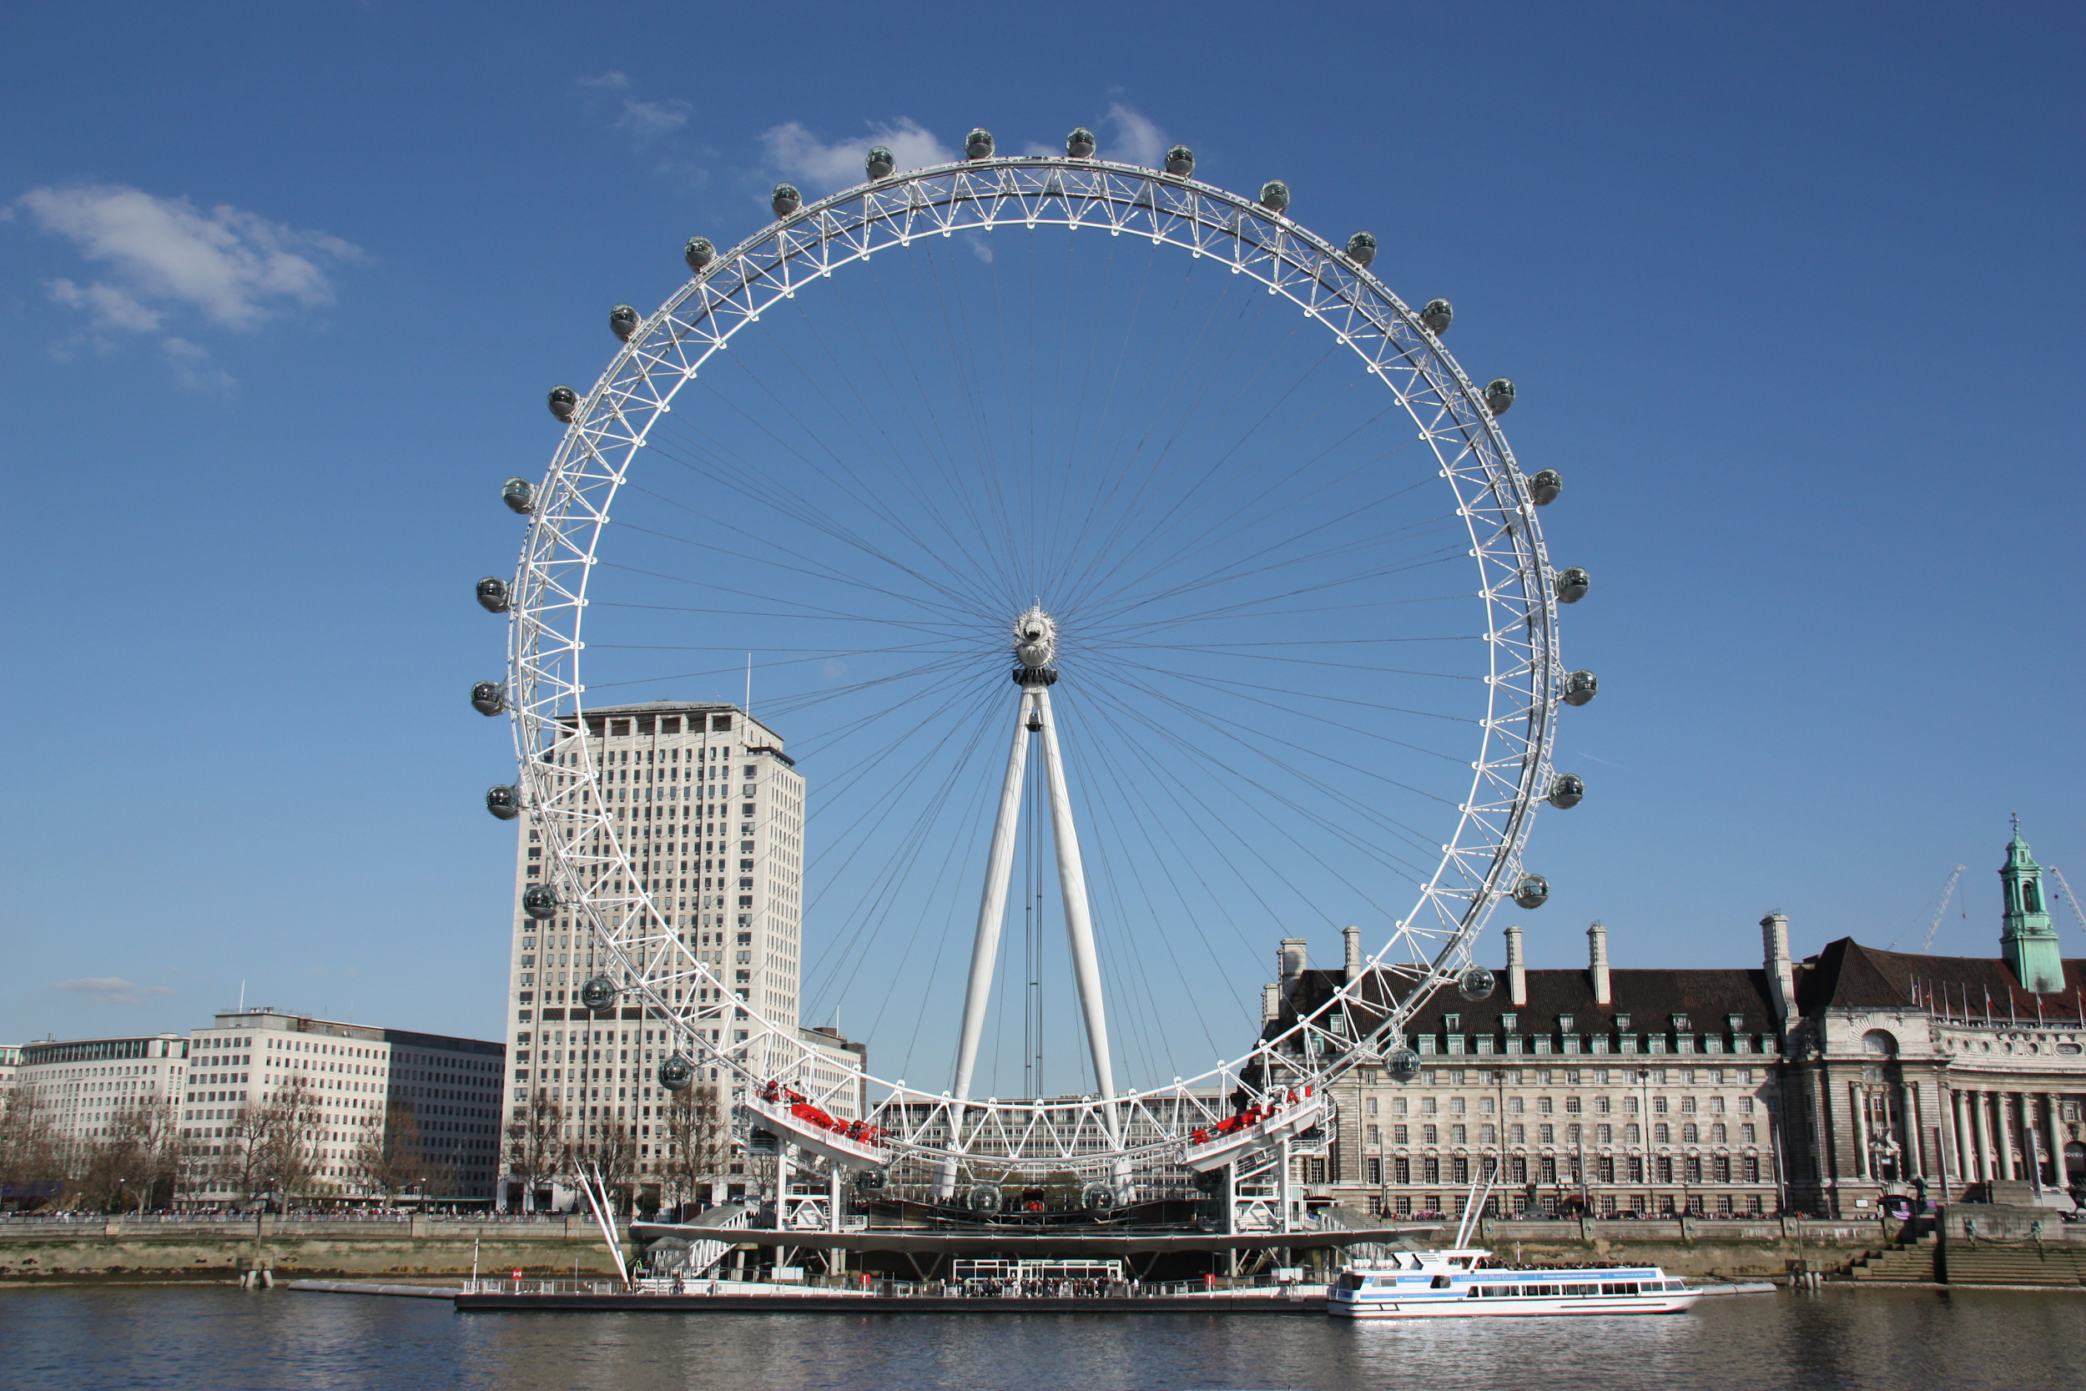
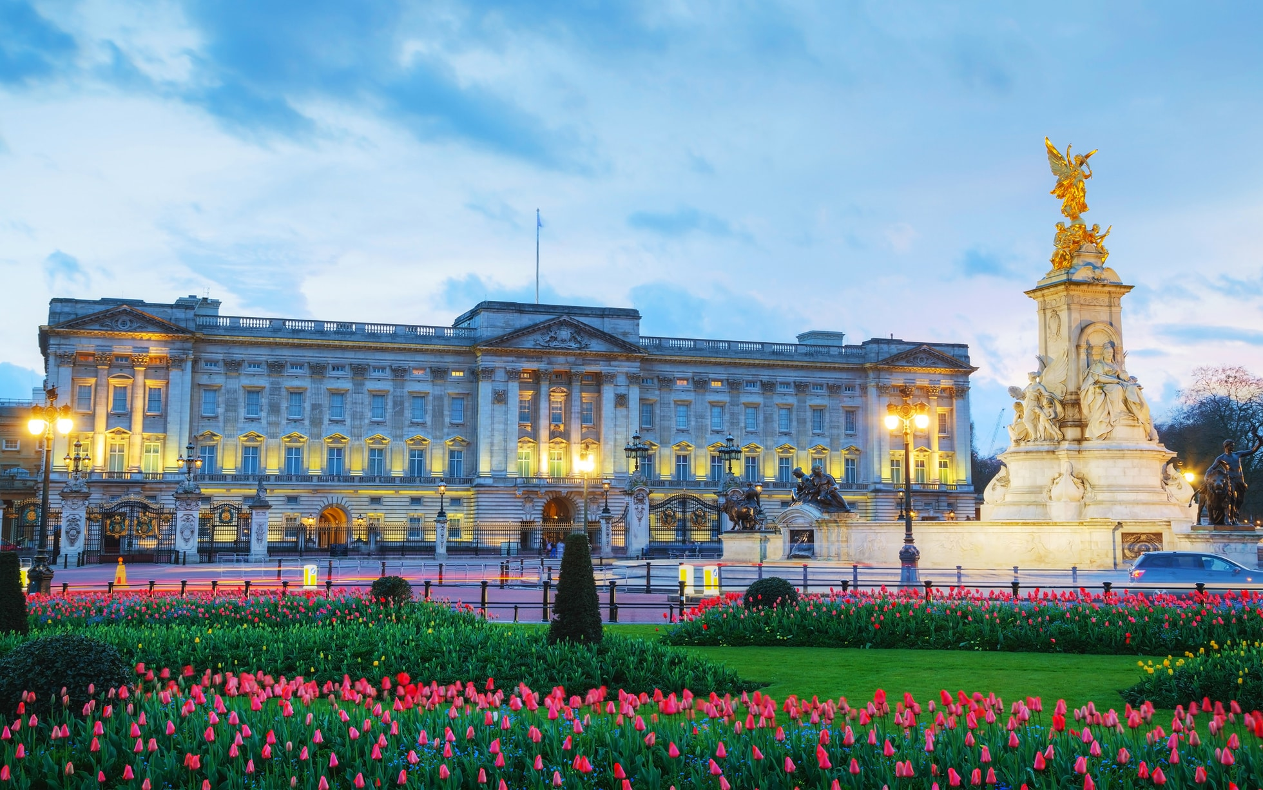
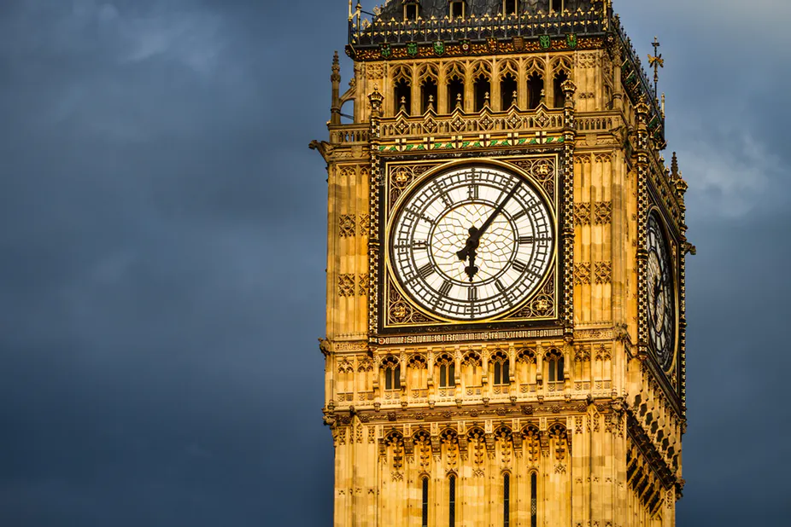
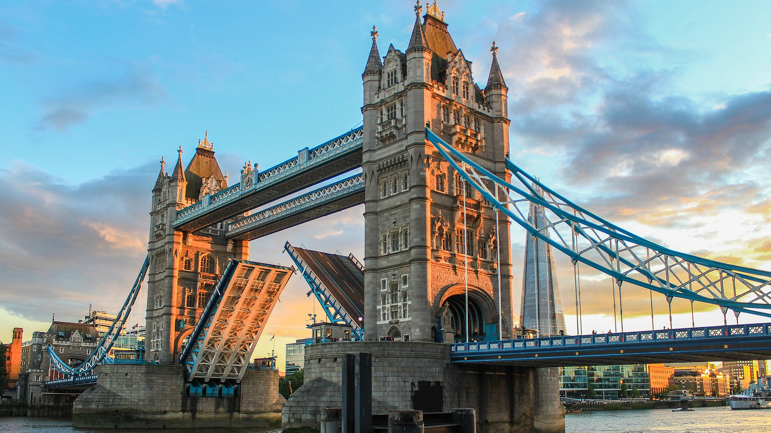
Famous sights
The Big Ben’s original name is Elizabeth tower
The 135 meter tall London Eye
The Buckingham Palace
The Tower bridge on river Thames

Slide 6
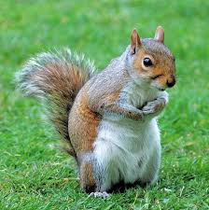
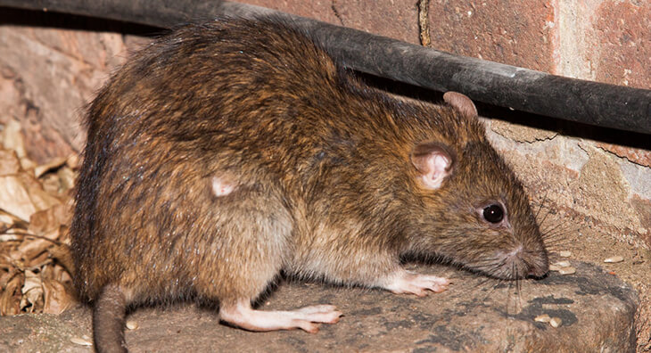
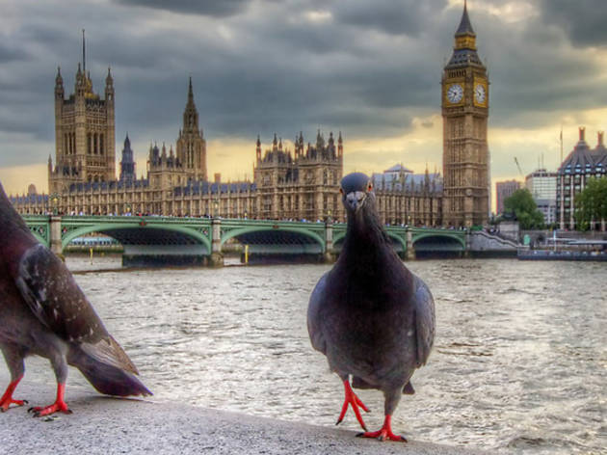
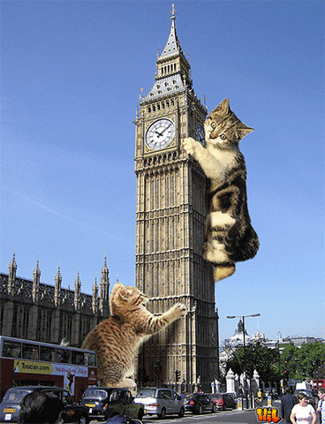
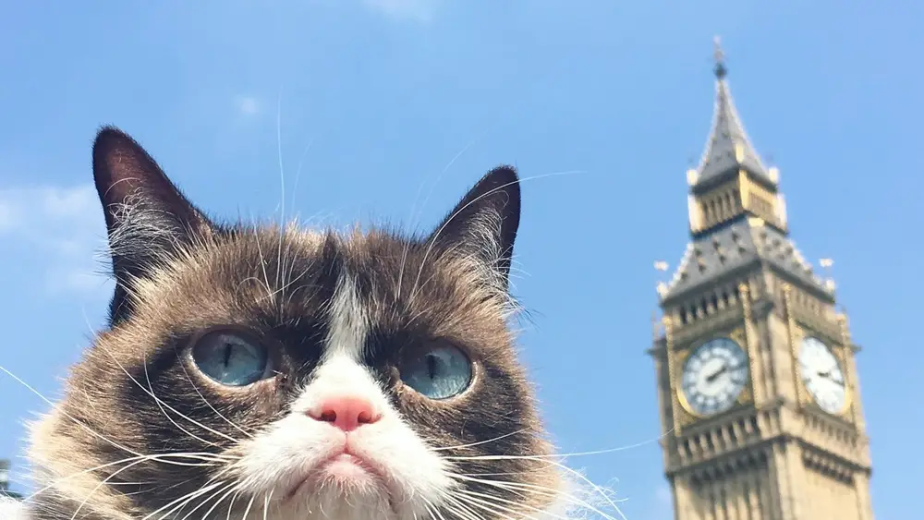
Animals in London
Squirrel
Rat
Pigeon
Pet dogs / cats

Slide 7
Thanks for watching
btw I couldn’t figure out how to make it look fancy
By: Botond Rákász

