Slide 1
Live a helthier life for 30 days!

Slide 2
What the challenge is?
Everyday eat something healthy.
Do exercise every day.
Be in fresh air.
Sleep 8 hours.
shower with cold water in the morning.

Slide 3
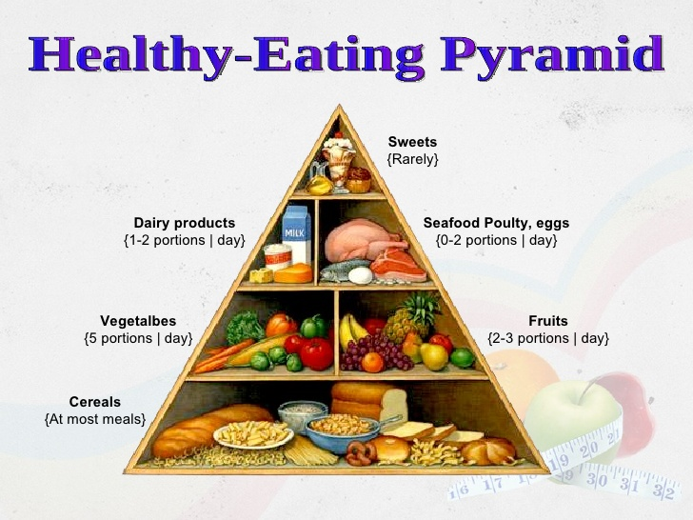
Healthy diet
Positive:
Meats
Fruits
Vegetables
dairy products
Negative:
Fast foods
Fatty foods
Oily foods

Slide 4
What my previous experience is?
These things I have listed here I have been doing for 2 months and trying to incorporate more and more new things into it.
I really enjoyed the last months and I also feel that I am much more energetic, and I can thinking faster and I sleep better in the evenings.

Slide 5
How I think it might change you?
It will be difficult in the beginning but over time it will become a habit.
you will be much more energetic, happier and fitter.
it can change your whole life.

Slide 6
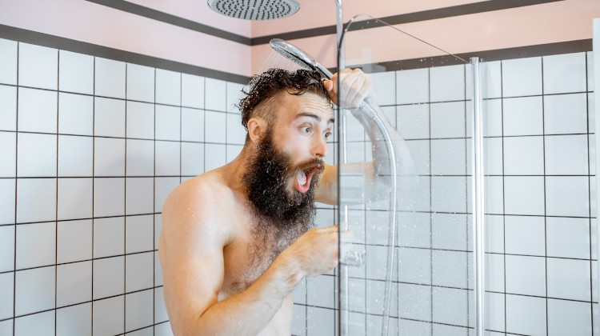
Exra information: why is the morning cold shower good?
A cold shower improves circulation.
Cold water reduces mental symptoms.
Has a beneficial effect against panic attacks. (and against depression)

Slide 7
THANKS FOR WATCHNG!

