Slide 1
Environment protection
Készítette: kun Tamara

Slide 2
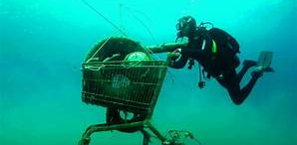
Pollution
Lately, a lot of people talk about pollution which is an important thing.
This is a fact that needs to be changed we pollute our environment in many ways which will have serious consequences.
Pollution for example:
Air pollution
Littering
Natural disaster
And even a bunch of everything

Slide 3
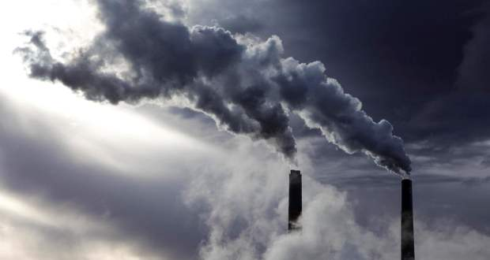
Air pollution
Air pollution is important because we all suck in these substances and they can be harmful to our lungs without even noticing.
Cars and factories play an important role in this, but unfortunately it is not possible to just close factories because many people would be unemployed.
Most clothing factories emit a lot of smoke into the air because 35% of the factories are clothing factories.

Slide 4
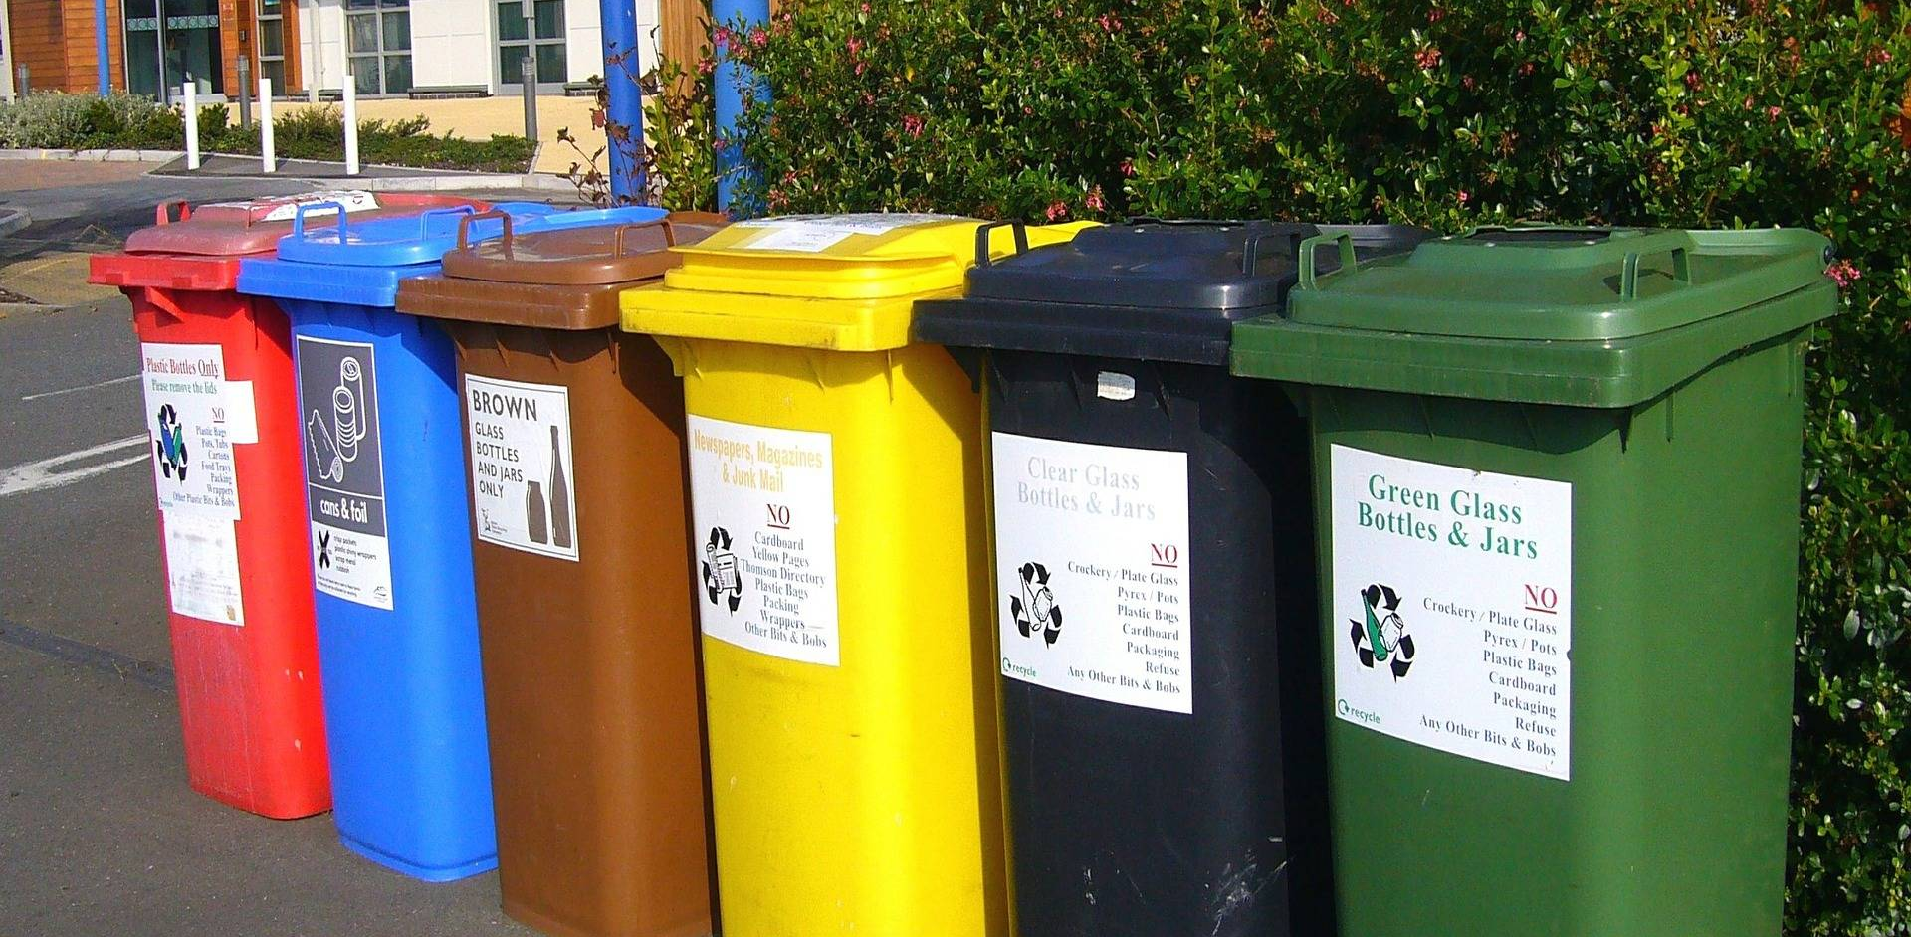
Littering
I think littering is the worst because it destroys the ecosystem.
For example:
Electrical waste
Plastic
Tin
In the landfill, a lot of garbage gets into the ground and pollutes the water, unfortunately we haven’t been able to answer that yet, but let’s try to buy as many recyclable things as possible.

Slide 5
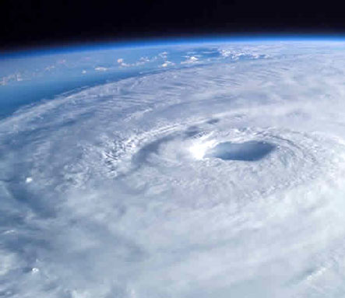
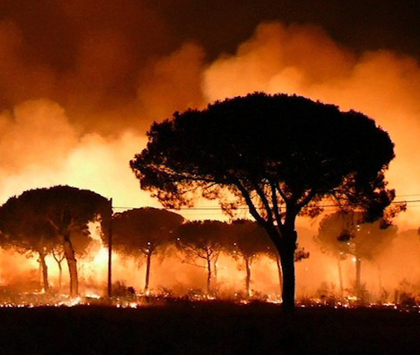
Natural disaster
A natural disaster is a big problem because it is expected because of people.
Forest fire
Earthquake
Hurricane
Tsunami
They are also harmful to humans, animals and plants too.
In these, many die or become homeless.

Slide 6
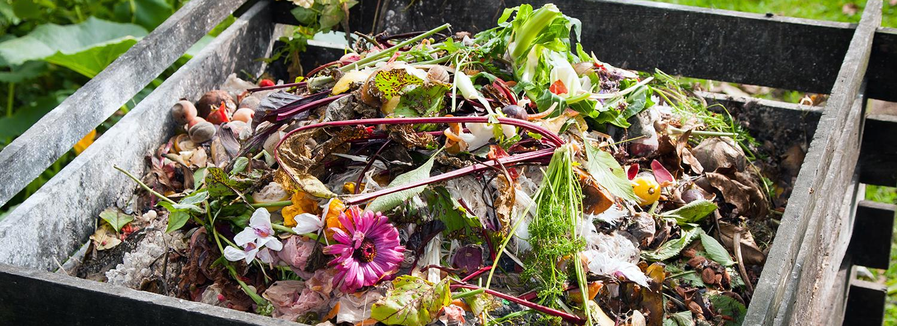
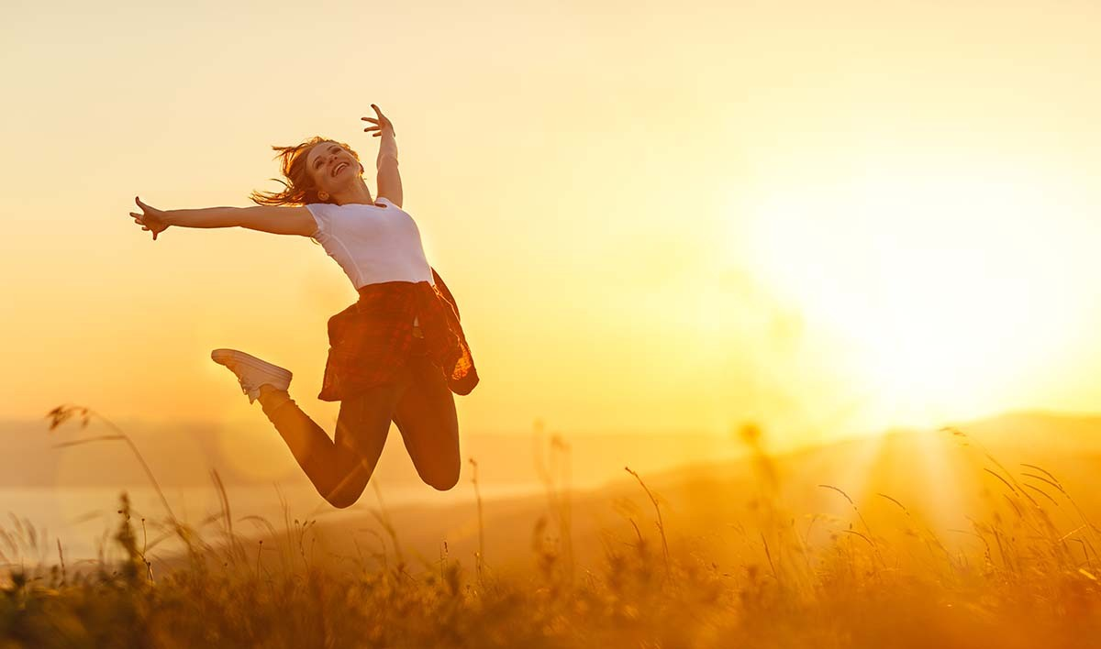
How can we help?
Try to collect selectively and walk by public transport or on foot, by bike because these will help us make the Earth better.
And we try it!
For example:
Buy recyclable things
Take used clothes
Let's go by public transport
Do not cut down trees

Slide 7
Thank you for watching!

