Slide 1
Released in 1995.
Historical fiction war film
Won 5 Oscars
Directed by Mel Gibson
Cast:
Mel Gibson as William Wallace
Sophie Marceau as princess Isabella
Patrick McGoohan as Edward "Longshanks„
Angus Macfadyen as Robert the Bruce

Slide 2
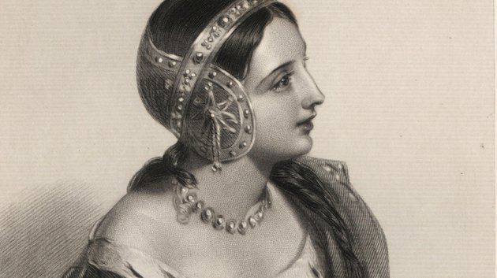
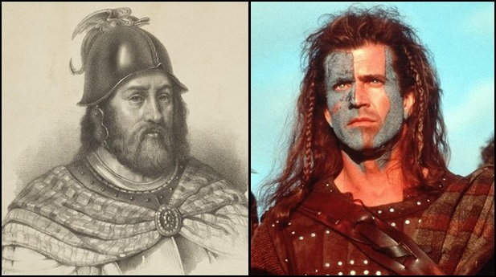
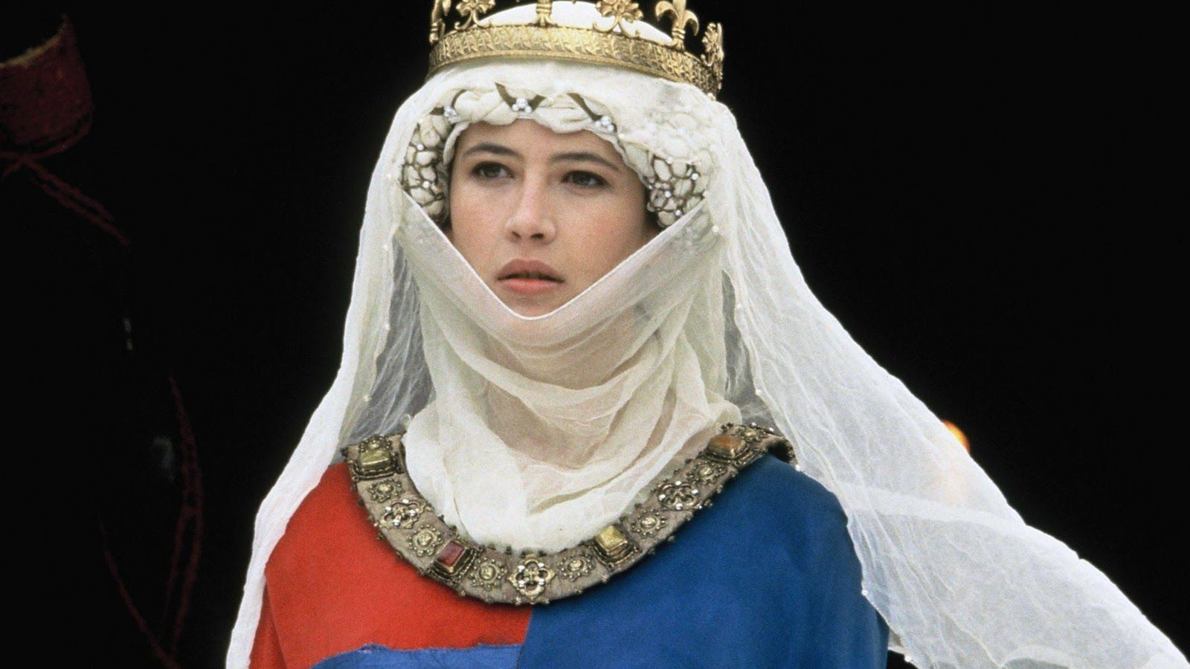
William Wallace: Mel Gibson
William Wallace was a 13th century scottish knight, and one of the main leaders of the First War of Scottish Independence.
Princess Isabella: Sophie Marceau
Daughter of Philip IV of France and spouse of Edward II of England.

Slide 3
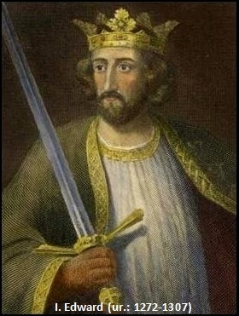
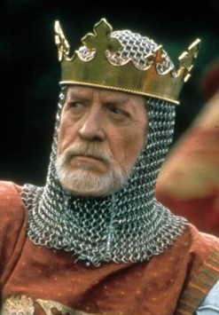
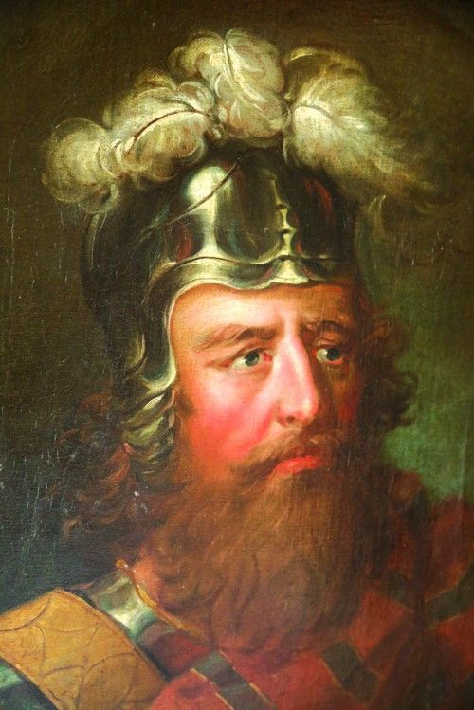
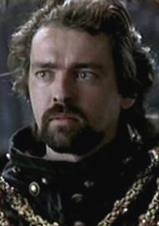
Longshanks: Patrick McGoohan
Edward I, king of England
Robert the Bruce: Angus Macfadyen
Robert I, King of the Scots

Slide 4
Historic background:
In 1290, after the death of the Scottish monarch Margaret of Norway, 13 Scottish nobles applied to occupy the throne. They were all trying to prove that they were entitled to the royal title of Scotland through their ancestors. Eventually, the Balliol clan seized the throne in 1292 when John Balliol declared himself as the new king. But the Scottish nobility disputed his eligibility, and many wanted Robert the Bruce as king instead. The Scottish barons asked King Edward I of England to settle the dispute, but he arrived in Scotland with a huge army, and sided with John Balliol. He sided with him under an important condition: Balliol had to take an oath of fealty to him. With this oath, Edward became the lord of Balliol and thus of Scotland. Edward took the stone of Scone.

Slide 5
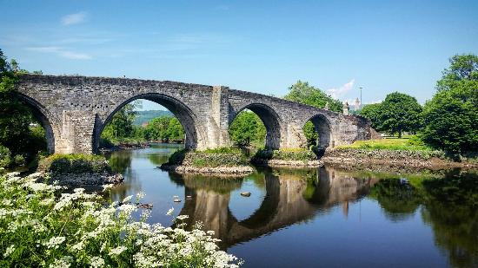
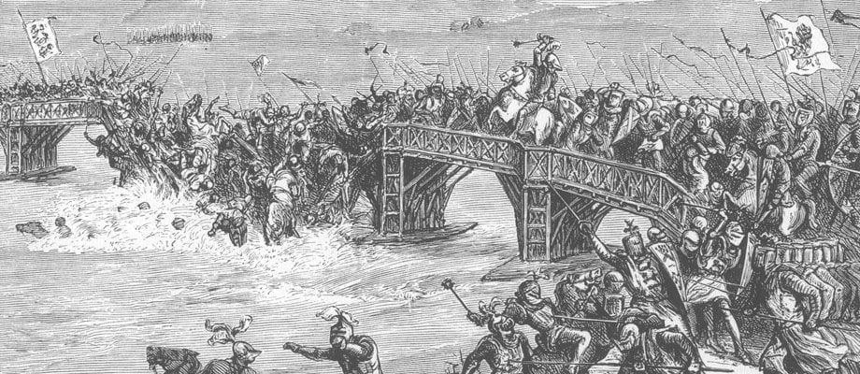
The tension between Scots and Brits kept getting higher until 1297. The final straw was the revolt of a nobleman called William Wallace, near Lanark. After his wife was murdered, he killed the Sheriff or Lanark, William Heselrig. The English issued an arrest warrant against Wallace, who fled to the Scottish mountains, where thousands of Scottish peasants and warriors joined him. Their first victories over the British took place at Loudoun Hill and Ayr.
In the great battle at the Stirling Bridge on September 11, 1297, the Scots won a tremendous victory, so Robert the Bruce, who from 1297, the fall of Balliol, considered himself the leader of Scotland, dubbed Wallace a knight.

Slide 6
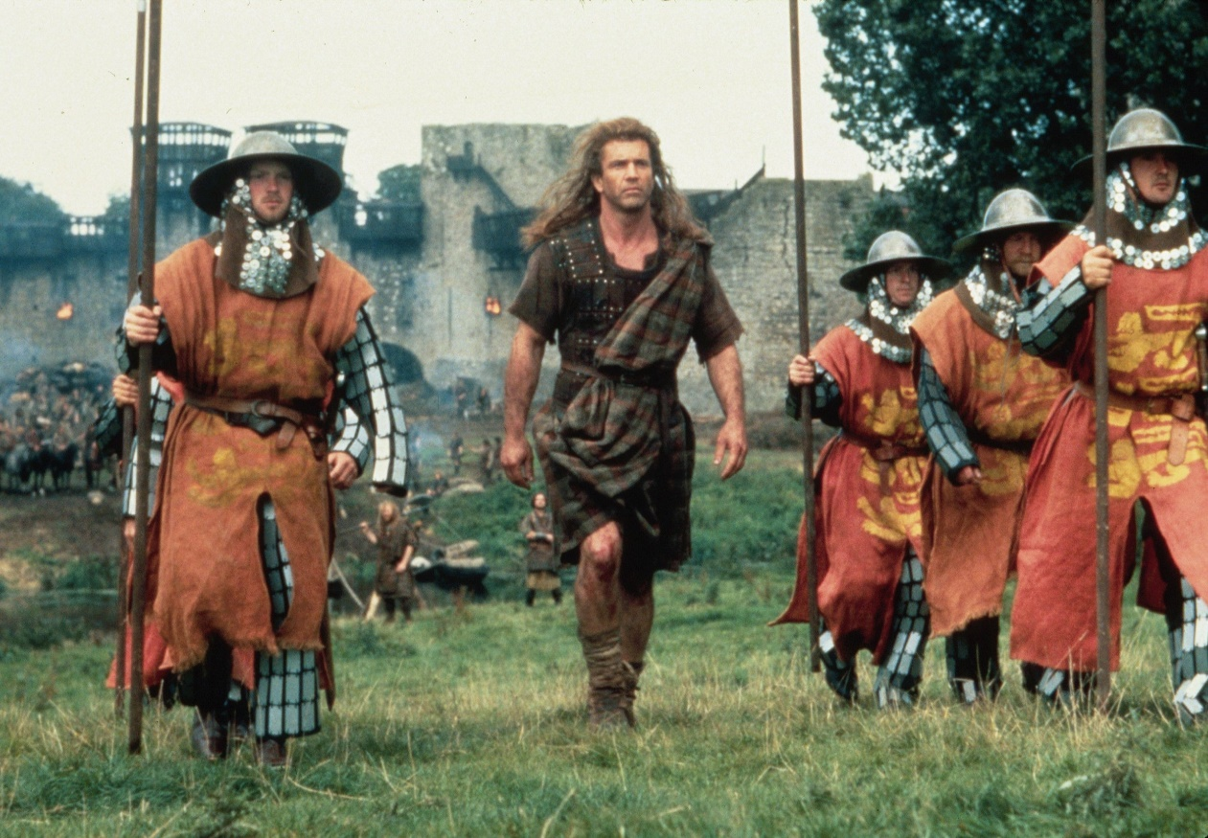
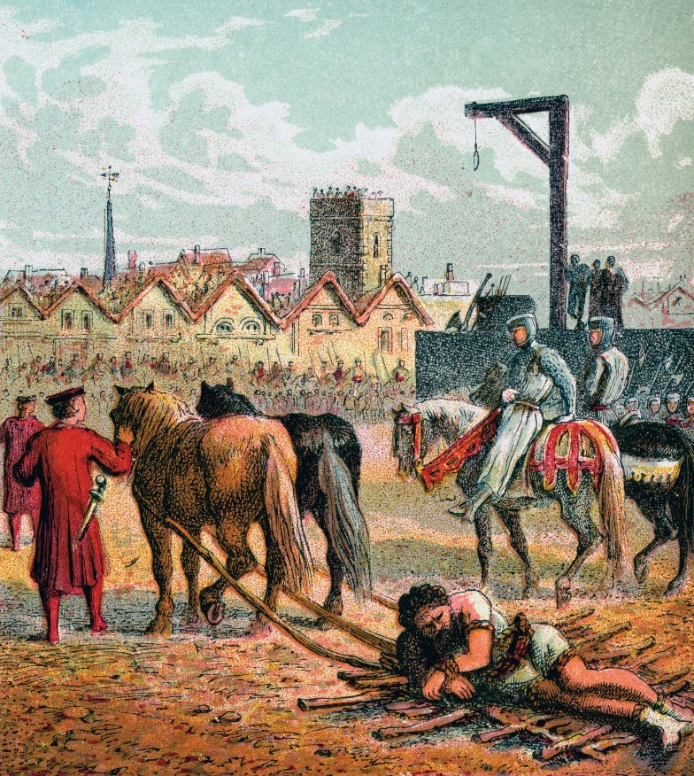
Longshanks, on the other hand gathered 15000 soldiers, and swore revenge on Scotland. Wallace couldn't gather nearly as many fighters as Edward, but he was prepared for the clash. The battle took place on July 22, 1298, near Falkirk (40km from Glasgow). During the battle, the Scottish nobles left the infantry, so Wallace lost. Wallace was finally captured in 1305 (betrayed by a Robert’s father) and executed in London on August 23, 1305.

Slide 7
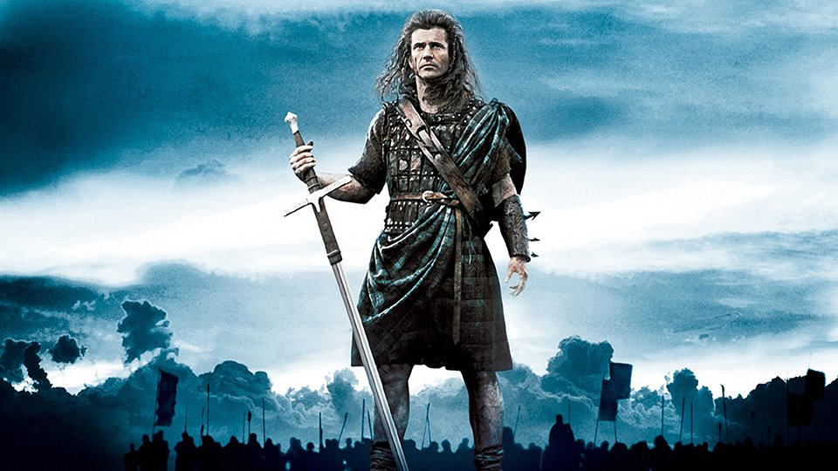
Sources:
Wikipedia
Made by:
Csurgó-Laczkó Gergely

