Slide 1
London
London

Slide 2
Location:
London is the capital and largest city of England and the United Kingdom. Standing on the River Thames in the south-east of England, at the head of its 50-mile (80 km) estuary leading to the North Sea, London has been a major settlement for two millennia.

Slide 3
London Population:
9,304,016
The latest official estimate of the population of London comes from the Office for National Statistics. According to their data, the estimated population of Greater London in 2016 is 8,787,892. The metro population in 2020 is estimated to be as much as 9.30 million according to the UN's World Urbanization Prospects.
London's population makes it by far the largest city in the United Kingdom. The second largest city in the UK - Birmingham - has a population of 1.1 million.
It is the third largest city in Europe, behind Istanbul (14.8 million) and Moscow (10.3 million), and the 27th most populous metro area in the world, slightly larger than Lima, Peru.

Slide 4
River Thames:
The River Thames, known alternatively in parts as the Isis, is a river that flows through southern England including London. At 215 miles (346 km), it is the longest river entirely in England and the second-longest in the United Kingdom, after the River Severn. It flows through Oxford (where it is called the Isis), Reading, Henley-on-Thames and Windsor. The lower reaches of the river are called the Tideway, derived from its long tidal reach up to Teddington Lock. It rises at Thames Head in Gloucestershire, and flows into the North Sea via the Thames Estuary. The Thames drains the whole of Greater London.

Slide 5
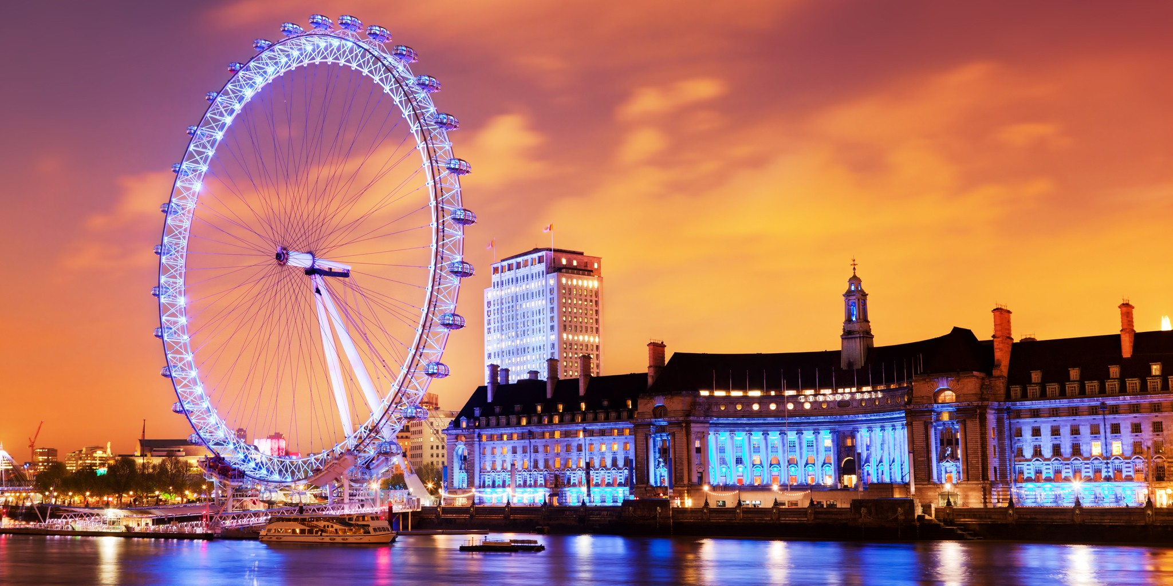
Famous Sights:
Big Ben is the nickname for the Great Bell of the striking clock at the north end of the Palace of Westminster in London and is usually extended to refer to both the clock and the clock tower.
The London Eye, or the Millennium Wheel, is a cantilevered observation wheel on the South Bank of the River Thames in London.
The official name of the tower in which Big Ben is located was originally the Clock Tower, but it was renamed Elizabeth Tower in 2012 to mark the Diamond Jubilee of Elizabeth II.
It is Europe's tallest cantilevered observation wheel, and is the most popular paid tourist attraction in the United Kingdom with over 3.75 million visitors annually, and has made many appearances in popular culture.

Slide 6
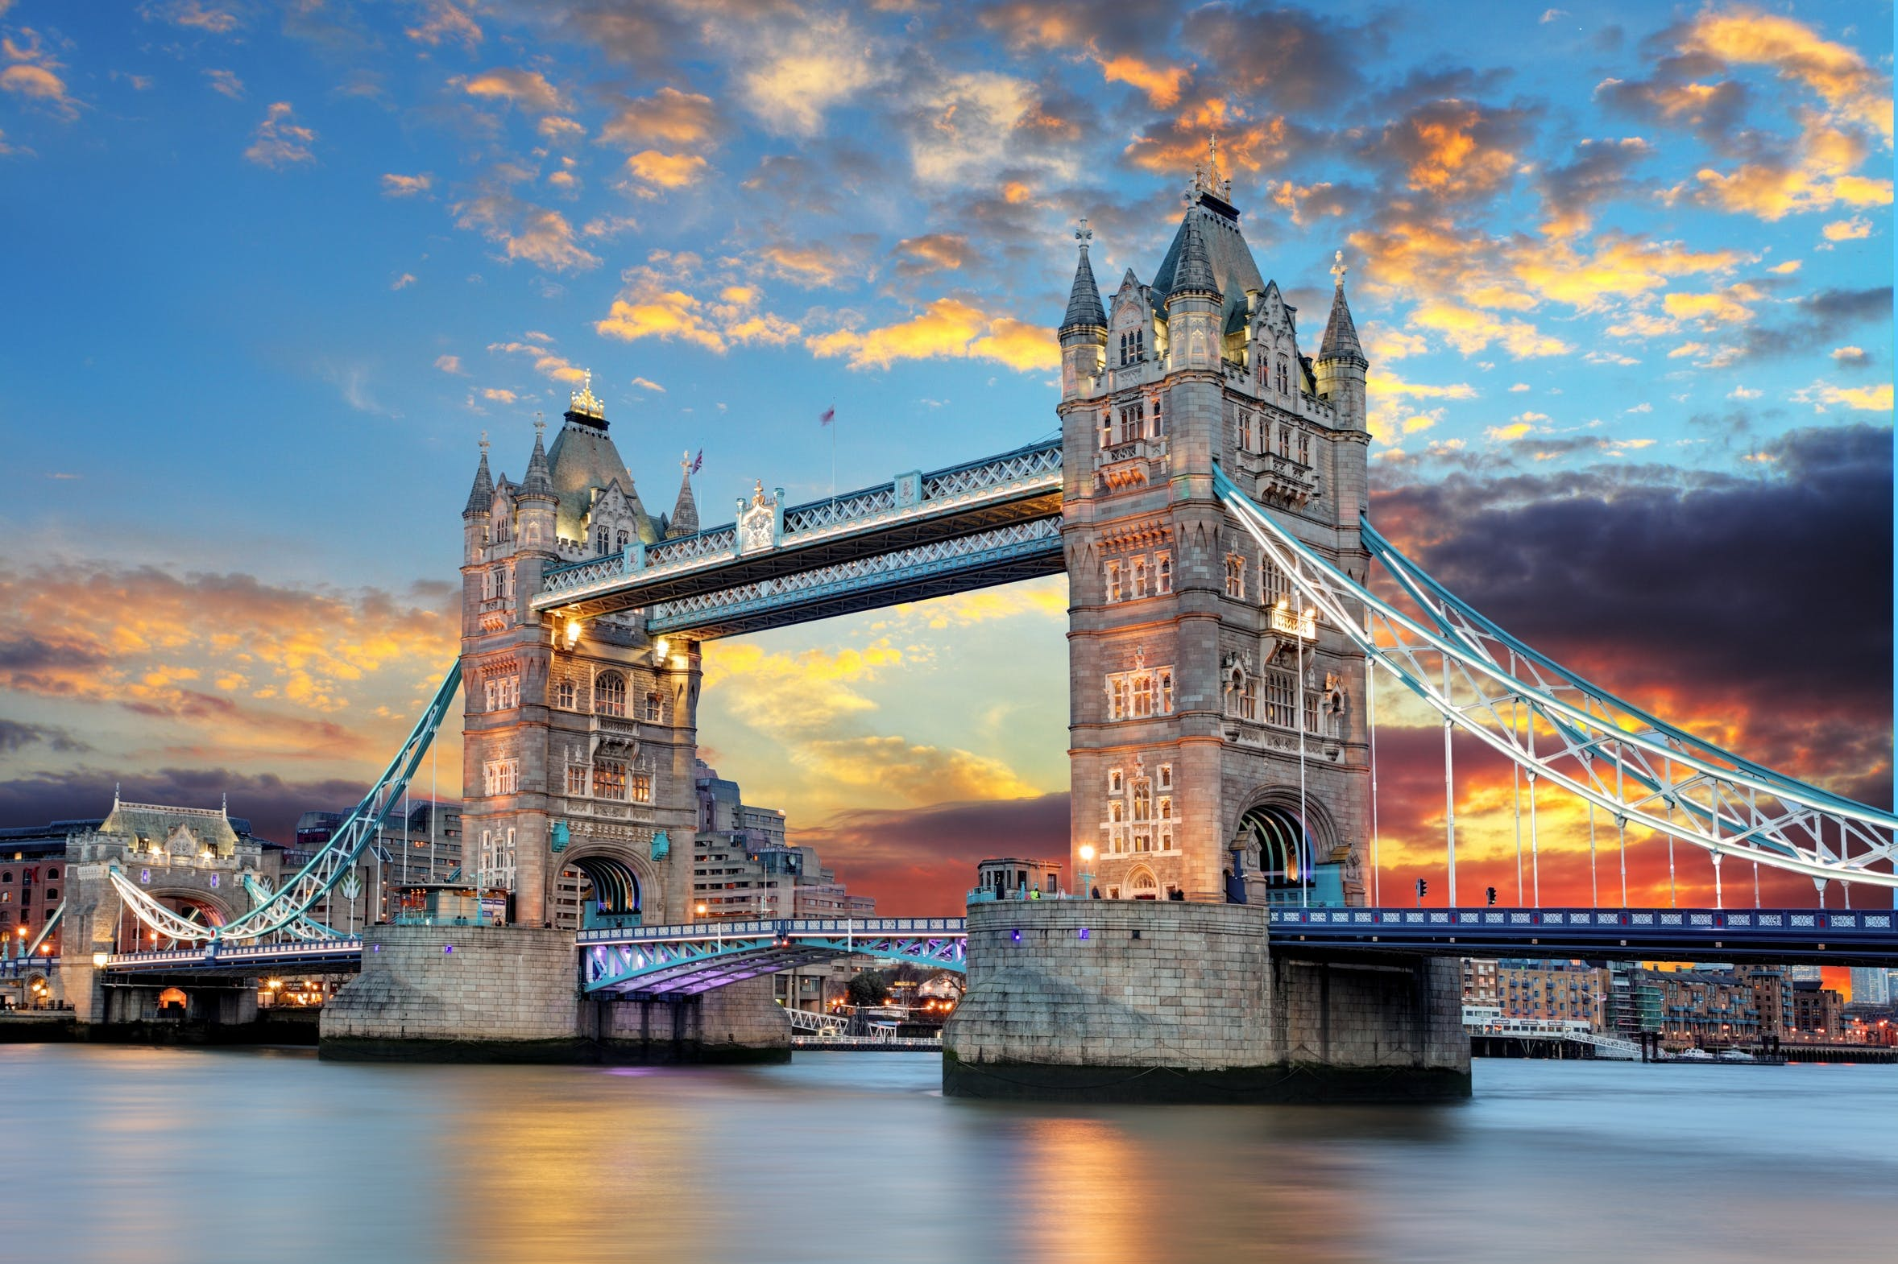
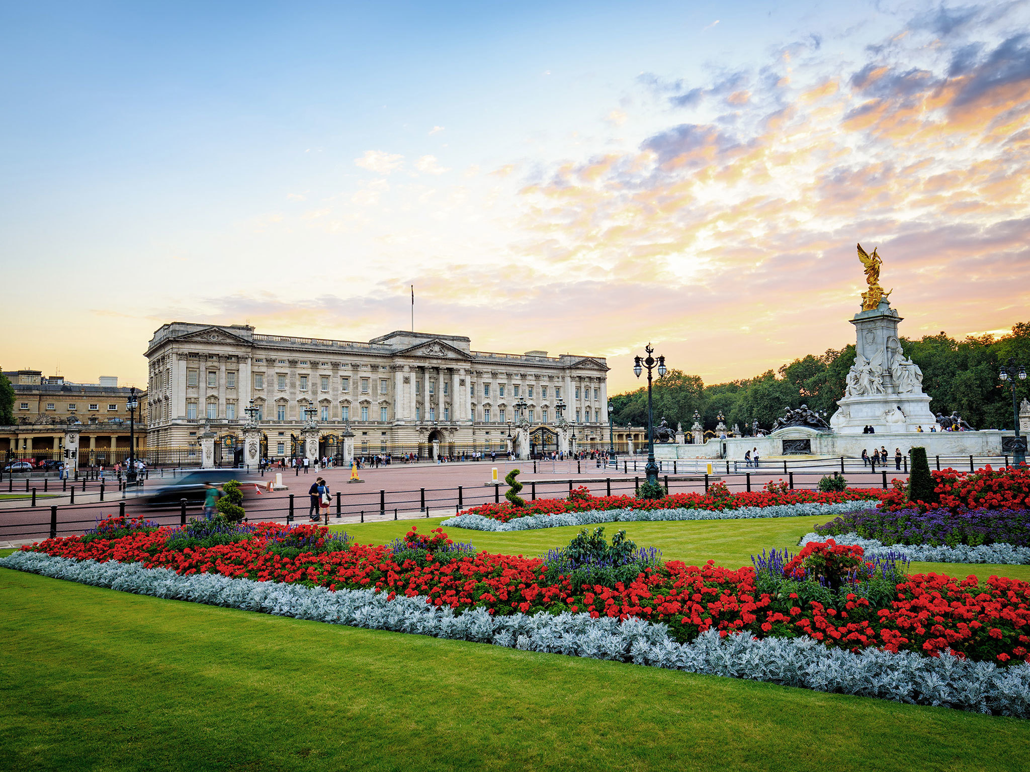
The Tower of London, officially Her Majesty's Royal Palace and Fortress of the Tower of London, is a historic castle located on the north bank of the River Thames in central London.
Buckingham Palace is the London residence and administrative headquarters of the monarchy of the United Kingdom.
It lies within the London Borough of Tower Hamlets, which is separated from the eastern edge of the square mile of the City of London by the open space known as Tower Hill. It was founded towards the end of 1066 as part of the Norman Conquest of England.
Located in the City of Westminster, the palace is often at the centre of state occasions and royal hospitality. It has been a focal point for the British people at times of national rejoicing and mourning.

Slide 7
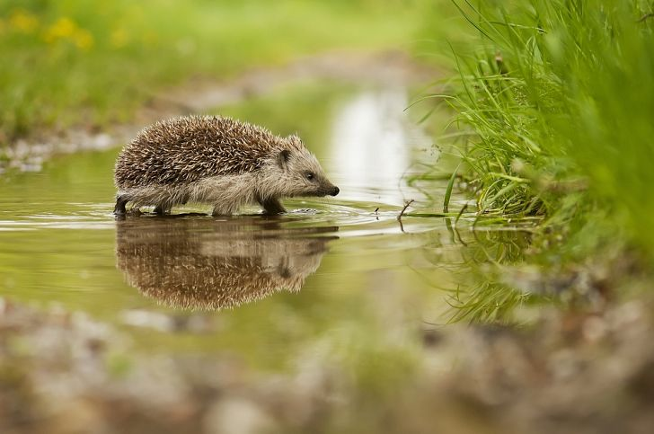
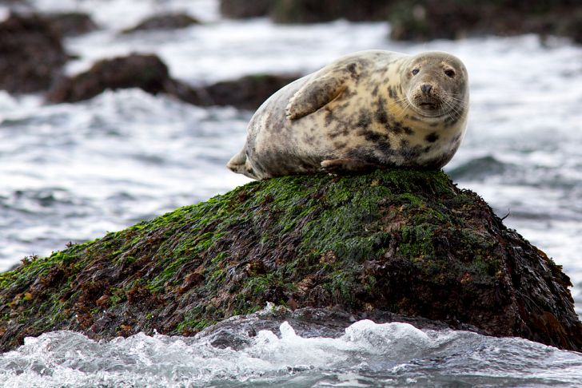
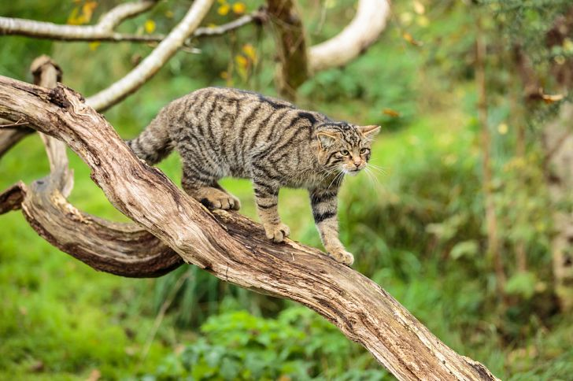
Animals in the UK:
The European Hedgehogs
The Scottish Wildcat
The Grey Seal
It is a native animal of Britain, and it is mostly found on the British coast. The grey seal is most famous in the United Kingdom as they are largest breeding mammals found in this region. At birth, the grey seal is said to weigh approximately 14 kilograms.
They are the only remaining largest wild predators found in the United Kingdom. The Scottish wildcats are solitary animals and seem to live together only during the mating season. This species is described as being an excellent predator as it is fearless, intelligent and mighty.
They are the only spiky animals found in the United Kingdom. This animal has a perfect sense of smell and hearing but lacks good eyesight. The European Hedgehogs are known to hibernate during winter and become active during summer.

